Slide 1
Mini-batch SGD for digit recognition
Scikit-learn - Digits

Slide 2

Welcome
Md. Sharafat Karim ID : 2102024, Reg: 10151
Md. Tanvir Islam ID : 2102043, Reg: 10170
Notes:
Welcome to Board autoprofiler!
I’m Sadman Kabir
I’m Sharafat Karim

Slide 3
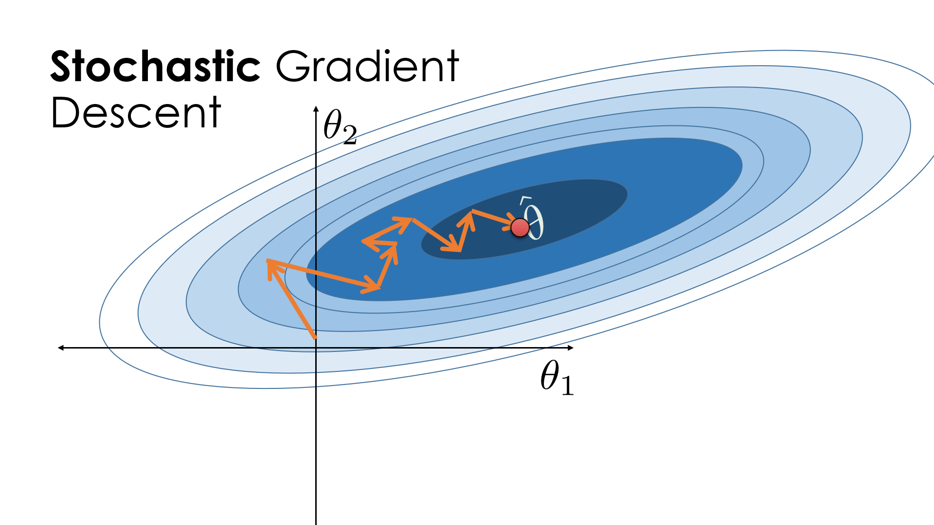
SGD
Stochastic Gradient Descent (SGD) is an optimization technique used in machine learning to minimize errors in predictive models by updating model parameters based on a single data point or a small batch at a time, rather than the entire dataset
Notes:
আমরা কম্পিউটারের বিভিন্ন কম্পোনেন্ট এর ক্রয় বিক্রয় এর ব্যাপারে কাজ করেছি

Slide 4

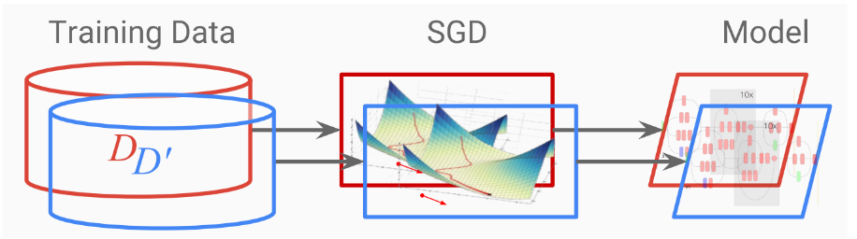
Load a dataset
Train a model based on it with SGD
Run tests on samples
Analyze the test result
Digits Identification
Identifity digits from images dataset...

Slide 5
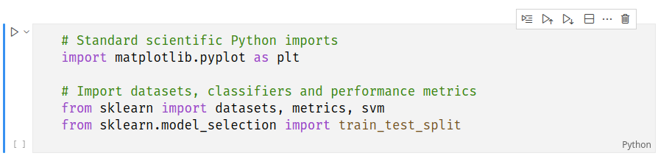
Selecting libraries
Dataset

Slide 6
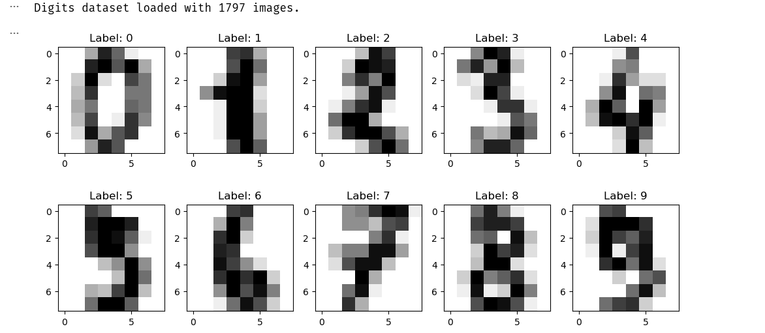

Slide 7
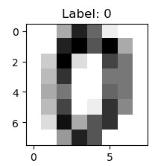


Flattening images...
SVC (Support vector machine)

Slide 8
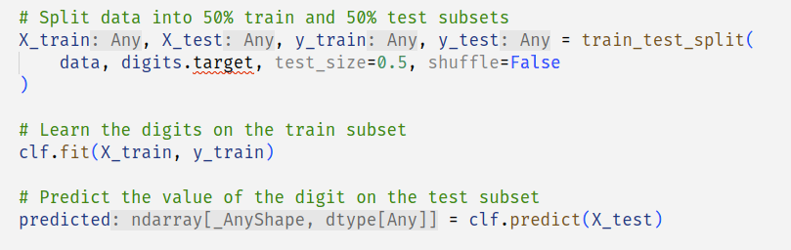
Splitting the data...

Slide 9
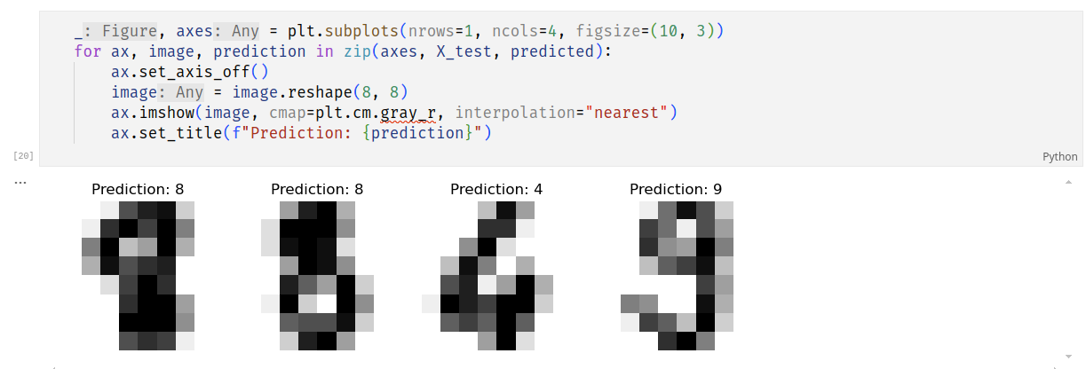

Slide 10
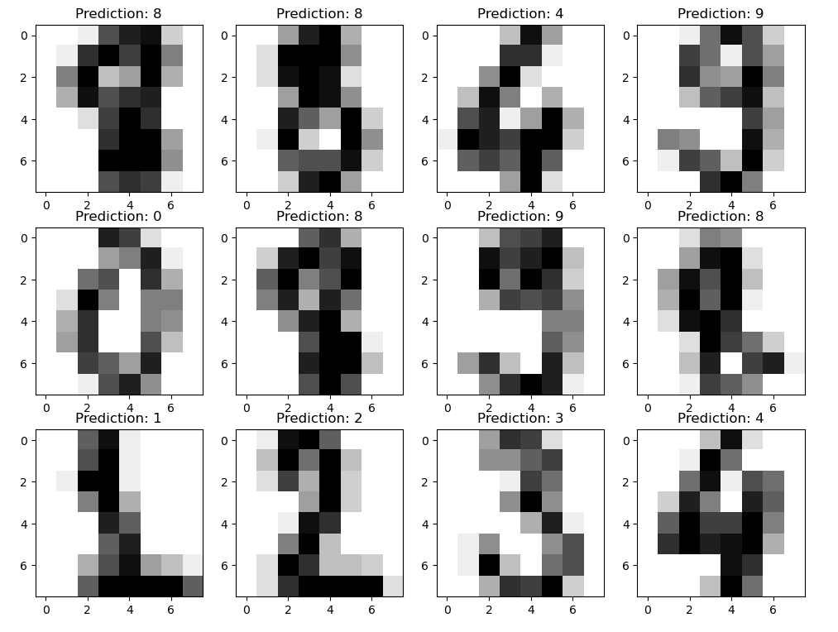

Slide 11
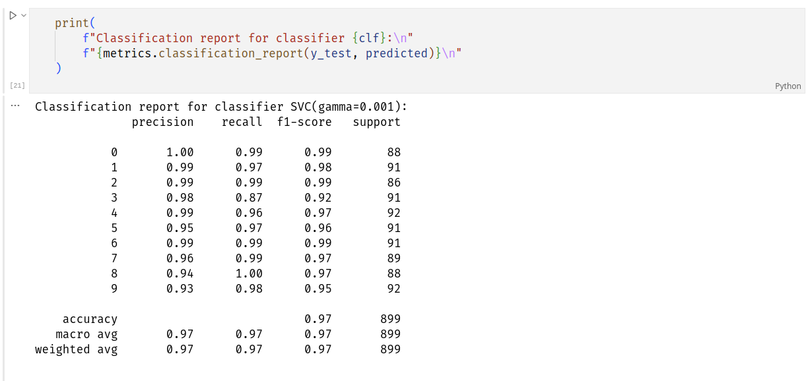

Slide 12
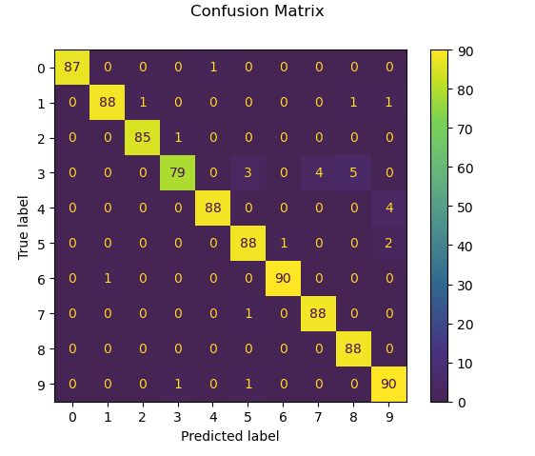

Slide 13

Thank you
For watching…

